Slide 1
RESUME PARSER AI PROJECT
Streamlining Recruitment with Advanced Natural Language Processing and Machine Learning Classifiers
BS-Computer Science | 5th Semester Final Project
MEMBERS
Fazal Ud Deen Hashmi (01-134241-011)
Muhammad Shamyl (01-134232-133)_
Syed Rayyan Shah Bokhari (01-134241-044)

Slide 2

THE CHALLENGE: RECRUITMENT AT SCALE
Skimming Efficiency: Recruiters spend an average of only 6 seconds per resume.
Data Overload: Hundreds of applications for a single position require automated filtering.
Anti-Spam Filtering: Modern AI must identify skilled candidates while filtering out "keyword stuffing."
Contextual Understanding: Moving beyond simple keyword matching to semantic skill grouping.

Slide 3






TECHNOLOGICAL ARCHITECTURE
Python Core
NLTK & Scikit-Learn
Tkinter GUI
The backend foundation leveraging Pandas and NumPy for efficient data manipulation and array processing.
NLTK for text preprocessing (tokenization, lemmatization) and Scikit-Learn for the KNN classifier and vectorizer.
A desktop-based interface providing seamless user interaction for dataset loading and resume analysis.

Slide 4



UNDERSTANDING TERM FREQUENCY (TF)
Term Frequency (TF) measures how frequently a specific term occurs in a single resume. It represents the "local importance" of a word.
Key Insight
If a word like "Python" appears many times in a resume, the TF score increases, signaling that the candidate might have high expertise in that skill.
Where f(t,d) is the count of term t in document d.

Slide 5
IDF & THE TF-IDF RELATION
Inverse Document Frequency (IDF) penalizes common words (like "the", "and") across the entire collection of resumes.
Why it works
Stop words appear in every document, making their IDF near zero. Rare technical skills appear in few documents, maximizing their relevance.
The Relation: The final weight is the product of both scores.

Slide 6
PREPROCESSING PIPELINE
Lowercase Conversion: Standardizing text to ensure "Python" and "python" are treated identically.
Noise Removal: Using Regular Expressions (Regex) to strip URLs, emails, numbers, and special characters.
Tokenization: Breaking long blocks of text into individual units or "tokens."
Stopword Removal: Filtering out non-informative words using the NLTK English stopword corpus.
Lemmatization: Reducing words to their root form (e.g., "Designing" becomes "Design") using WordNetLemmatizer.

Slide 7

ML MODEL: K-NEAREST NEIGHBORS
Why KNN for Text?
The K-Nearest Neighbors (KNN) algorithm is highly effective for text classification once resumes are converted into numerical vectors in a feature space.
• Non-Parametric: Makes no assumptions about data distribution. • Similarity-Based: Resumes with similar skills naturally cluster together. • Voting: We use K=5, meaning the model looks at the 5 closest resumes to decide the category.

Slide 8
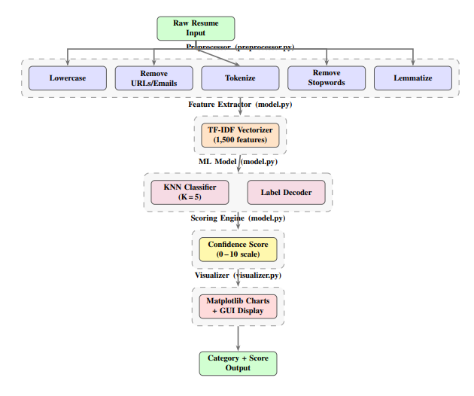
SYSTEM ARCHITECTURE
User Input: Raw resume text provided via GUI.
Preprocessing: NLTK cleaning pipeline.
Vectorization: TF-IDF transformation into 1500 features.
Classifier: Trained KNN model predicts category.
Output: Result display with scores and charts.

Slide 9

SCORING & CONFIDENCE LOGIC
Probability Scaling
0-10
The score is derived from KNN Prediction Confidence. If all 5 neighbors agree on a category, the confidence is 1.0, yielding a perfect 10/10 score.
• Score ≥ 7: Strong Candidate • Score ≥ 4: Moderate Candidate • Score < 4: Weak Candidate
Weightage Score

Slide 10
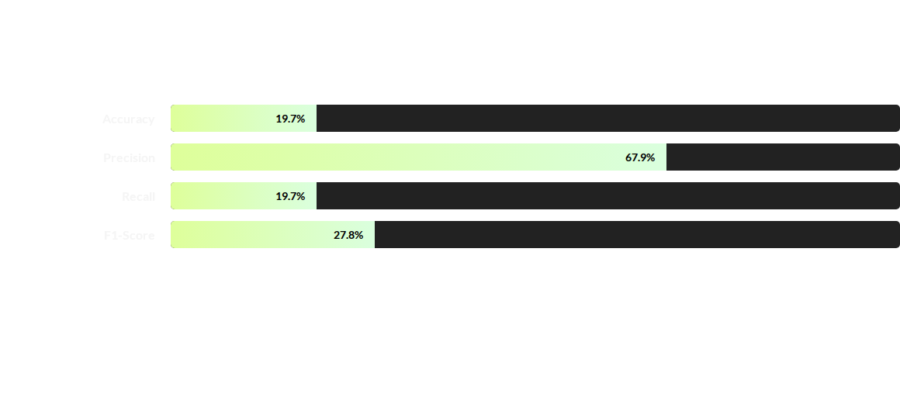
MODEL PERFORMANCE
Note: Lower accuracy is expected due to 28 high-similarity job categories sharing overlapping technical vocabulary.

Slide 11
DATASET SUMMARY
Feature | Detail
Source | Kaggle Resume Dataset
Record Count | 9,544 Resumes
Job Categories | 28 (Data Science, Java Dev, HR, etc.)
Target Variable | job_position_name
Train/Test Split | 80% Training / 20% Testing

Slide 12
ANY QUESTIONS?
Thank you for your attention.
Project GitHub Repository : https://github.com/shamylcoder/AI-Project-Lab

